Slide 1

Next word prediction

Slide 2
INTRODUCTION
Language prediction is a Natural Language Processing - NLP application concerned with predicting the text given in the preceding text. Auto-complete or suggested responses are popular types of language prediction. The first step towards language prediction is the selection of a language model.
There are generally two models you can use to develop Next Word Suggester/Predictor:
1) N-grams model
2) Long Short Term Memory (LSTM).

Slide 3
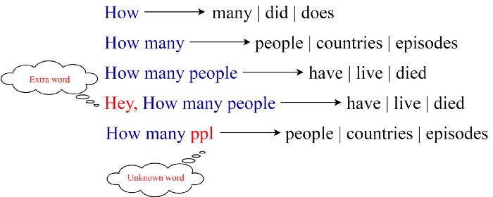

Slide 4
N-grams approach
If you’re going down the n-grams path, you’ll need to focus on the ‘Markov Chains’ to predict the likelihood of each following word or character based on the training corpus.
Limitations:
Markov chains do not have memory. There are many limitations to adopting this approach. Take an example, “I ate so many grilled …” next word “sandwiches” will be predicted based on how many times “grilled sandwiches” have appeared together in the training data. As we are getting suggestions based only on the frequency, there are many scenarios where this approach could fail.

Slide 5
Long Short Term Memory (LSTM) approach:
A more advanced approach, using a neural language model, is to use Long Short Term Memory (LSTM). LSTM model uses Deep learning with a network of artificial “cells” that manage memory, making them better suited for text prediction than traditional neural networks and other models.
Standard RNNs and other language models become less accurate when the gap between the context and the word to be predicted increases. Here’s when LSTM comes in use to tackle the long-term dependency problem because it has memory cells to remember the previous context.

Slide 6
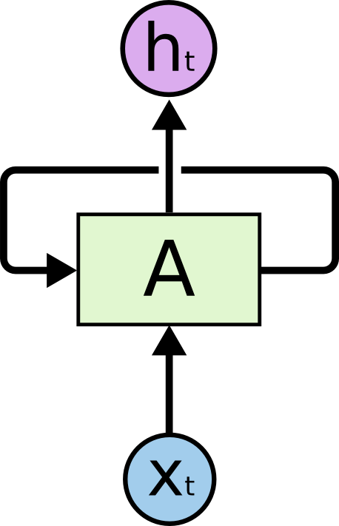
Recurrent Neural Networks:
Humans don’t start their thinking from scratch every second. As you read this essay, you understand each word based on your understanding of previous words. You don’t throw everything away and start thinking from scratch again. Your thoughts have persistence.
Traditional neural networks can’t do this, and it seems like a major shortcoming. For example, imagine you want to classify what kind of event is happening at every point in a movie. It’s unclear how a traditional neural network could use its reasoning about previous events in the film to inform later ones.

Slide 7
The Problem of Long-Term Dependencies
One of the appeals of RNNs is the idea that they might be able to connect previous information to the present task, such as using previous video frames might inform the understanding of the present frame. If RNNs could do this, they’d be extremely useful. But can they? It depends.
Sometimes, we only need to look at recent information to perform the present task. For example, consider a language model trying to predict the next word based on the previous ones. If we are trying to predict the last word in “the clouds are in the sky,” we don’t need any further context – it’s pretty obvious the next word is going to be sky. In such cases, where the gap between the relevant information and the place that it’s needed is small, RNNs can learn to use the past information.

Slide 8
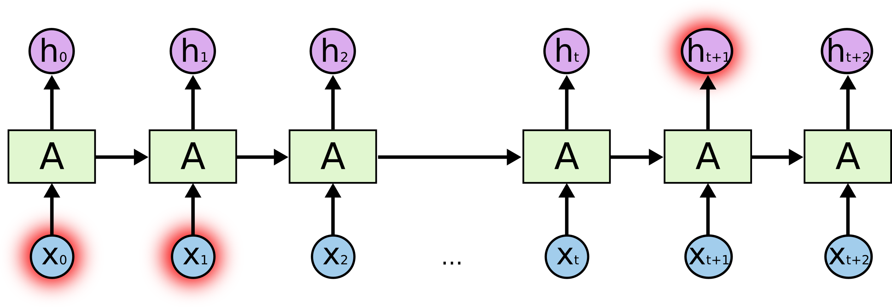
Limitations
But there are also cases where we need more context. Consider trying to predict the last word in the text “I grew up in France… I speak fluent French.” Recent information suggests that the next word is probably the name of a language, but if we want to narrow down which language, we need the context of France, from further back. It’s entirely possible for the gap between the relevant information and the point where it is needed to become very large.
Unfortunately, as that gap grows, RNNs become unable to learn to connect the information.

Slide 9

LSTM Networks
Long Short Term Memory networks – usually just called “LSTMs” – are a special kind of RNN, capable of learning long-term dependencies.
LSTMs are explicitly designed to avoid the long-term dependency problem. Remembering information for long periods of time is practically their default behavior, not something they struggle to learn!

